Slide 1
Unit 3
Knowledge Representation
Madhura Vyawahare

Slide 2
Syllabus
Propositional logic
Theory of first order logic
Inference in First order logic
Forward & Backward Chaining
Resolution

Slide 3
Knowledge
Knowledge: knowing something
Information one gained through learning or experience
The state of knowing about a particular fact or situation
Reasoning: Use of reasons
Process of thinking about something and making a judgement or decision
The drawing of inferences or conclusions through the use of reason
Intelligence:
Ability to learn something
The ability to understand, learn and think

Slide 4
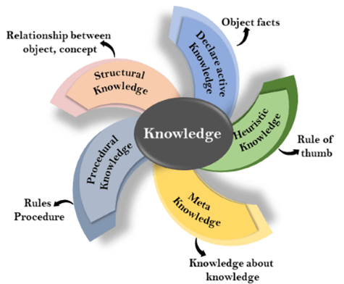
Types of Knowledge

Slide 5
Types of Knowledge
Declarative or Descriptive knowledge
Factual knowledge: capital of a country or the chemical formula for a substance
Conceptual knowledge: concepts of crimes, searching, justice or freedom
Theoretical knowledge: Newton’s law, laws of physics or the principles of economics
Procedural Knowledge
How to do things
Example: How to drive a car, how to register a complaint, how to write a program etc.
Meta Knowledge
Knowledge about knowledge
Example: reliability of algorithm, advantages of the procedure
Structural Knowledge
Architecture and design of a software system
Heuristic Knowledge
Heuristic knowledge is representing knowledge of some experts in a field or subject.

Slide 6
Knowledge Representation
I saw a man on hill with telescope
A chicken is ready to eat
The dog chased a cat, which ran up a tree. It waited at the bottom.
Who does "it" refer to??
The dog chased a cat, which ran up a tree. It waited at the top.
Who does "it" refer to??

Slide 7
Knowledge Representation
No ambiguity
No syntax error
No semantic error
Ways to represent Knowledge
Logic
Propositional
Predicate
Rules
Frames
Scripts
Semantic net

Slide 8
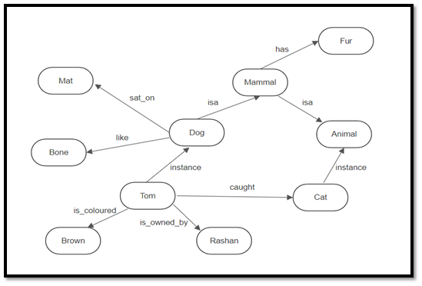
Knowledge Representation
No ambiguity
No syntax error
No semantic error
Ways to represent Knowledge
Logic
Propositional
Predicate
Rules
Frames
Scripts
Semantic net

Slide 9
What to Represent:
Following are the kind of knowledge which needs to be represented in AI systems:
Object: All the facts about objects in our world domain. E.g., Guitars contains strings, trumpets are brass instruments.
Events: Events are the actions which occur in our world.
Performance: It describe behavior which involves knowledge about how to do things.
Meta-knowledge: It is knowledge about what we know.
Facts: Facts are the truths about the real world and what we represent.
Knowledge-Base: The central component of the knowledge-based agents is the knowledge base. It is represented as KB.

Slide 10
Propositional Logic
Propositional Logic is the simplest form of logic
Logic is reasoning or thinking with knowledge
All the statements are made by propositions
A proposition is a declarative statement which is either true or false.
It is a technique of knowledge representation in logical and mathematical form.
Example:
a) It is Sunday.
b) The Sun rises from West (False proposition)
c) 3+3= 7(False proposition)
d) 5 is a prime number.

Slide 11
Propositional Logic
Propositional logic is also called Boolean logic as it works on 0 and 1.
It can have atomic or complex form of propositions
Parameters of Propositional Logic:
Variables: symbolic variables are used to represent the logic such A, B, C, P, Q, R, etc.
Local Constants: Propositions can be either true or false, it cannot be both.
Set of logic operators also known as logical connectives
The propositions and connectives are the basic elements of the propositional logic.
Connectives can be said as a logical operator which connects two sentences.
A proposition formula which is always true is called tautology, and it is also called a valid sentence.
A proposition formula which is always false is called Contradiction.

Slide 12
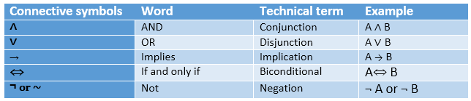

Slide 13
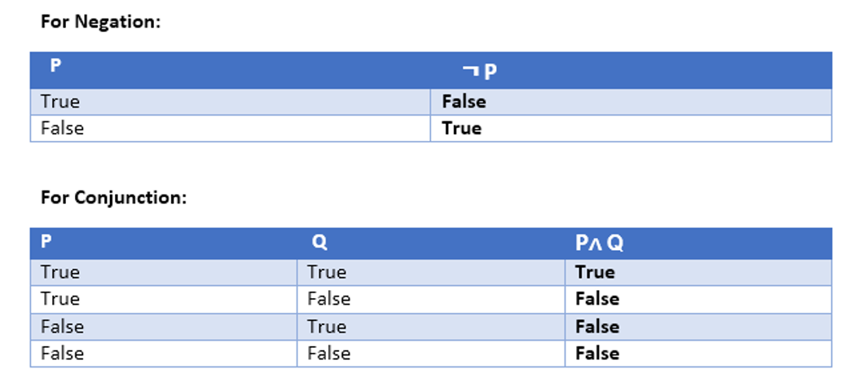

Slide 14
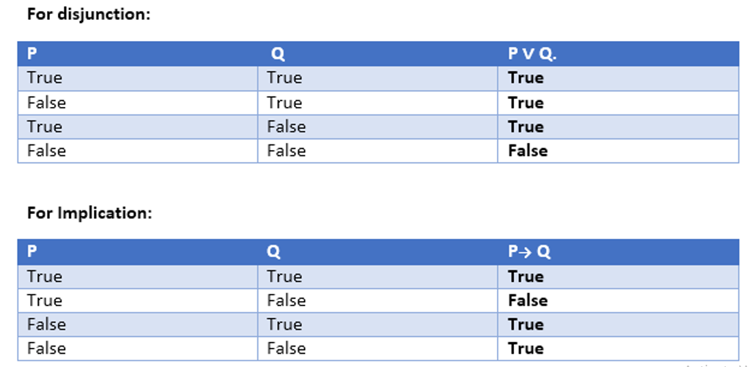

Slide 15
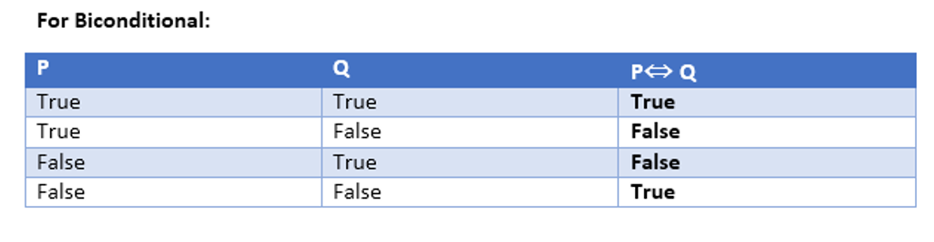

Slide 16
Examples
I have not completed paper checking.
Siya play basketball and siya loves shopping
It is raining or sun is shining
You should study or listen songs at a time
If it is raining then road is wet
If it is sunny, then I will go for a walk.
If you study hard, then and only then you will get good grades.
If the team wins the game, then the fans will be happy.
If the team wins the game, then and only then fans will be happy.

Slide 17
Examples
I have not completed paper checking.
completed paper checking = P
I have not completed paper checking = ¬P
Siya play basketball and siya loves shopping
Siya play basketball = P, siya loves shopping = Q
Siya play basketball and siya loves shopping = P ∧ Q
It is raining or sun is shining
It is raining =P, sun is shining = Q
It is raining or sun is shining = P ∨ Q
If it is raining then road is wet
it is raining = P, road is wet = Q
If it is raining then road is wet = P -> Q
If you study hard, then and only then you will get good grades.
you study hard = P, you will get good grades = Q
P ⇔ Q
If the team wins the game, then the fans will be happy.
If the team wins the game, then and only then fans will be happy.

Slide 18
“If it is sunny, then I will go for a walk”
Is it equivalent to
“If I go for a walk, then it is sunny”
If the team wins the game, then the fans are happy.
Is it equivalent to
“If fans are happy then, team wins the game”
Or “If fans are happy then team has won the game”

Slide 19
Make a truth table for the statement ¬P ∨ Q
Prove that the statements ¬( P → Q ) and P ∧ ¬Q are logically equivalent without using truth tables.
Are the statements (P∨Q)→R and (P→R)∨(Q→R) logically equivalent?
You can access the internet from the campus if you are CSBS students or you are not freshman
Are the statements, “it will not rain or snow” and “it will not rain and it will not snow” logically equivalent?

Slide 20
De Morgan's laws
¬ (P ∧ Q) = (¬P) ∨ (¬Q)
¬ (P ∨ Q) = (¬ P) ∧ (¬Q).

Slide 21
Propositional Logic
It is good start at describing the general principles of logical reasoning but does not give the means to express a general principle
Limitations of Propositional Logic
We cannot represent relations like ALL, some, or none with propositional logic. Example:
All the kids are cute.
Axis bank stock goes up on some mondays and goes down on all fridays
Propositional logic has limited expressive power.
In propositional logic, we cannot describe statements in terms of their properties or logical relationships.
To make sense of inferences like these, we need a logical system that can deal with objects, their properties, and relations between them.

Slide 22
Predicate Logic
Predicate logic overcomes the limitations of propositional logic
It is More expressive
More powerful as it uses quantifiers along with connectives
Also known as first-order logic, is a formal system for reasoning about statements involving quantifiers
In predicate logic, we use variables to represent objects or values, and predicates to express relationships or properties of those objects.
For example:
“The cat is sleeping in the sun.” The clause sleeping in the sun is the predicate and cat is an object
“Dog is a mammal who has fur”: The predicate "is a mammal" to describe an object dog, and "has fur" to describe a property of that object.

Slide 23
Predicate Logic
Predicate logic overcomes the limitations of propositional logic
It is More expressive
More powerful as it uses quantifiers along with connectives
Also known as first-order logic, is a formal system for reasoning about statements involving quantifiers
In predicate logic, we use variables to represent objects or values, and predicates to express relationships or properties of those objects.
For example:
“The cat is sleeping in the sun.” The clause sleeping in the sun is the predicate and cat is an object
“Dog is a mammal who has fur”: The predicate "is a mammal" to describe an object dog, and "has fur" to describe a property of that object.
“x + 2 = y” is a predicate and “2+2 = 4” is a proposition

Slide 24
First Order Predicate Logic
Atomic sentences and Complex Sentences:
Atomic sentences are the most basic sentences of first-order logic.
These sentences are formed from a predicate symbol followed by a parenthesis with a sequence of terms.
Complex sentences are formed from atomic sentences using connectives
We can represent atomic sentences as Predicate (term1, term2, ......, term n).
Example:
Ravi and Ajay are brothers: => brothers(ravi, ajay).
Chinky is a cat: => cat (chinky).
alexa(intelligent).
beautiful(dimple).
rahul(smart) / smart(rahul)
owns(sheetal,rose).
plays(amit,football).

Slide 25
Example:
plays(amit,football).
play(amit, rakhi,football).
play(amit, rekha, football).
play(amit, nitin, football).
Using variables:
plays(amit,X,football).
Rakhi;
Rekha;
nitin;
Using Connectives
likes(shikha,mango) ∧ likes(amit,mango).

Slide 26
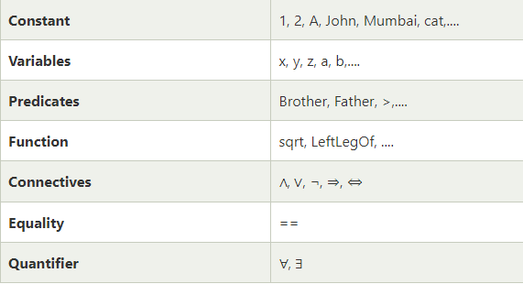
Basic Elements of First-order logic:

Slide 27
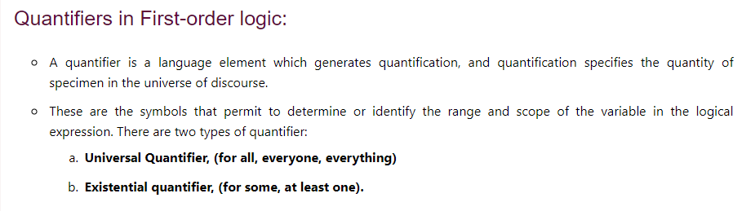

Slide 28
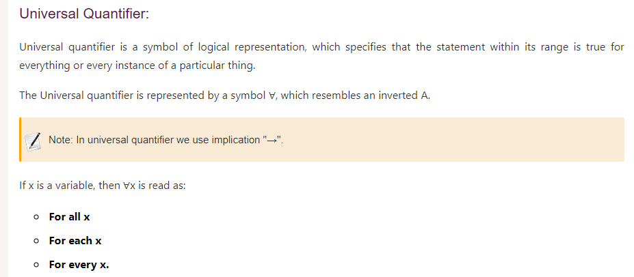

Slide 29

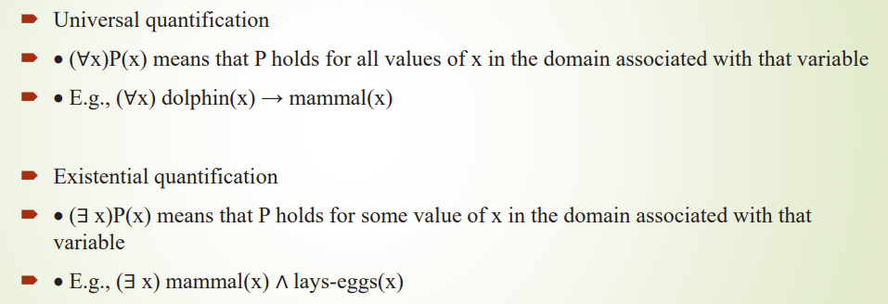
For all x if x is a dolphin then x is a mammal
There exist few x such that x is a mammal and x lays eggs

Slide 30
Examples
All birds fly
Every man respect his parents
Some boys play cricket
Not all students like maths and science

Slide 31
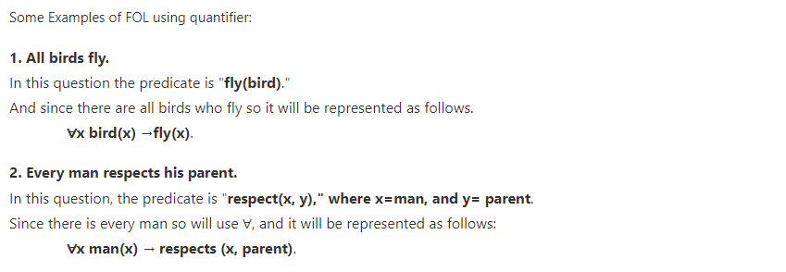

Slide 32
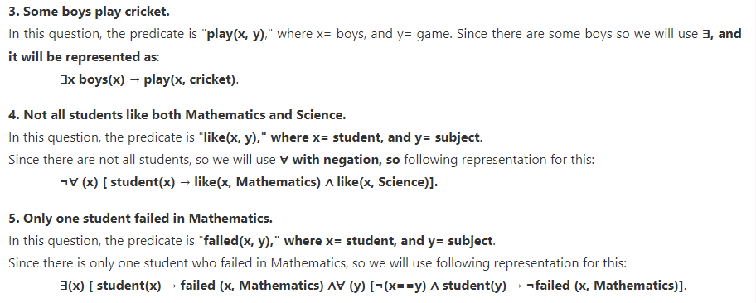

Slide 33
Examples
Predicate Logic Examples
John likes all kind of food.
Apple and vegetable are food
Anything anyone eats and not killed is food.
Anil eats peanuts and still alive
Harry eats everything that Anil eats.
Some humans are intelligent
Every child love candy

Slide 34
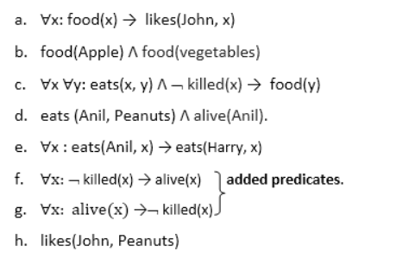

Slide 35
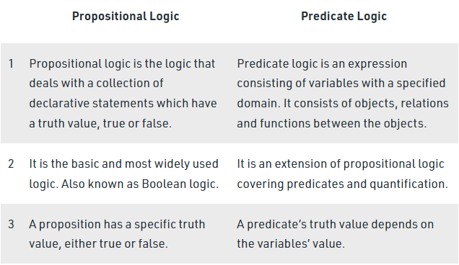

Slide 36
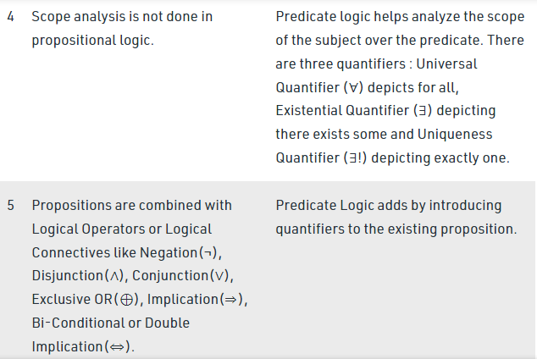

Slide 37
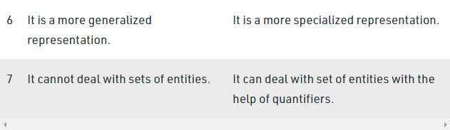

Slide 38
Prove John likes peanuts
Prove Harry eats peanuts
Prove Harry is alive

Slide 39
Inference in First Order Logic
Inference in First-Order Logic is used to deduce new facts or sentences from existing sentences
Substitution is used for inference
Substitution is a fundamental operation performed on terms and formulas
It occurs in all inference systems in first-order logic
The substitution is complex in the presence of quantifiers in FOL
If we write F[a/x], so it refers to substitute a constant "a" in place of variable "x".
Equality:
Brother (John) = Smith.
Modus Ponens (MP): P → Q If P is true then Q is true
Modus Tollens: if P→ Q and ¬ Q is true, then ¬ P will also true

Slide 40
Wumpus World Problem
The Wumpus world is a cave which has 4/4 rooms connected with passageways.
There are total 16 rooms which are connected with each other.
We have a knowledge-based agent who will go forward in this world.
The cave has a room with a beast which is called Wumpus, who eats anyone who enters the room.
The Wumpus can be shot by the agent, but the agent has a single arrow.
In the Wumpus world, there are some Pits rooms which are bottomless, and if agent falls in Pits, then he will be stuck there forever.
The exciting thing with this cave is that in one room there is a possibility of finding a heap of gold.
So the agent goal is to find the gold and climb out the cave without fallen into Pits or eaten by Wumpus.
The agent will get a reward if he comes out with gold, and he will get a penalty if eaten by Wumpus or falls in the pit.
Assumption: Wumpus is static and cannot move

Slide 41
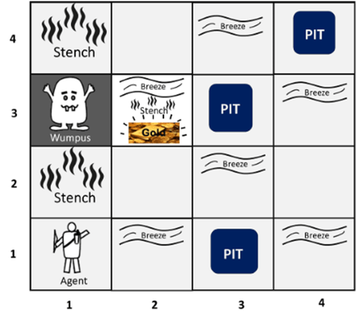

Slide 42
Wumpus world problem
There are also some components which can help the agent to navigate the cave. These components are given as follows:
The rooms adjacent to the Wumpus room are smelly, so that it would have some stench.
The room adjacent to PITs has a breeze, so if the agent reaches near to PIT, then he will perceive the breeze.
There will be glitter in the room if and only if the room has gold.
The Wumpus can be killed by the agent if the agent is facing to it, and Wumpus will emit a horrible scream which can be heard anywhere in the cave.

Slide 43
PEAS Description of Wumpus World
To explain the Wumpus world we have given PEAS description as below:
Performance measure:
+1000 reward points if the agent comes out of the cave with the gold.
-1000 points penalty for being eaten by the Wumpus or falling into the pit.
-1 for each action, and -10 for using an arrow.
The game ends if either agent dies or came out of the cave.
Environment:
A 4*4 grid of rooms.
The agent initially in room square [1, 1], facing toward the right.
Location of Wumpus and gold are chosen randomly except the first square [1,1].
Each square of the cave can be a pit with probability 0.2 except the first square.

Slide 44
PEAS Description of Wumpus World
Actuators:
Left turn
Right turn
Move forward
Grab
Shoot.

Slide 45
PEAS Description of Wumpus World
Sensors:
The agent will perceive the stench if he is in the room adjacent to the Wumpus. (Not diagonally).
The agent will perceive breeze if he is in the room directly adjacent to the Pit.
The agent will perceive the glitter in the room where the gold is present.
The agent will perceive the bump if he walks into a wall.
When the Wumpus is shot, it emits a horrible scream which can be perceived anywhere in the cave.
These precepts can be represented as five element list, in which we will have different indicators for each sensor.
Example if agent perceives stench, breeze, but no glitter, no bump, and no scream then it can be represented as:
[Stench, Breeze, None, None, None].

Slide 46
Wumpus World Properties
Partially observable: The Wumpus world is partially observable because the agent can only perceive the close environment such as an adjacent room.
Deterministic: It is deterministic, as the result and outcome of the world are already known.
Sequential: The order is important, so it is sequential.
Static: It is static as Wumpus and Pits are not moving.
Discrete: The environment is discrete.
One agent: The environment is a single agent as we have one agent only and Wumpus is not considered as an agent.

Slide 47
Wumpus World Execution
If the room is safe we will add symbol OK.
A is used to represent agent,
B for the breeze,
G for Glitter or gold,
V for the visited room,
P for pits,
W for Wumpus.
S for stench

Slide 48
Solving Wumpus World Using Logic
Let P_{i,j} be true if there is a Pit in the room [i, j].
Let B_{i,j} be true if agent perceives breeze in [i, j],
Let W_{i,j} be true if there is wumpus in the square[i, j].
Let S_{i,j} be true if agent perceives stench in the square [i, j].
Let V_{i,j} be true if that square[i, j] is visited.
Let G_{i,j} be true if there is gold (and glitter) in the square [i, j].
Let OK_{i,j} be true if the room is safe.

Slide 50
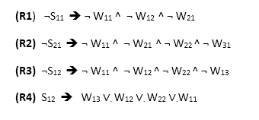
Solving Wumpus World using Propositional Logic
Some Propositional Rules for the wumpus world:
By De Morgan's laws

Slide 51
Solving Wumpus World using Propositional Logic
Representation of Knowledge Base for Wumpus world:
¬W11 | V11 | ¬S11 | ¬P11 | ¬B11 | ¬G11 | OK11
¬W21
¬W12

Slide 52
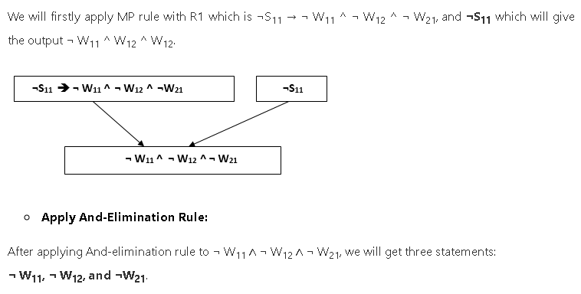

Slide 53
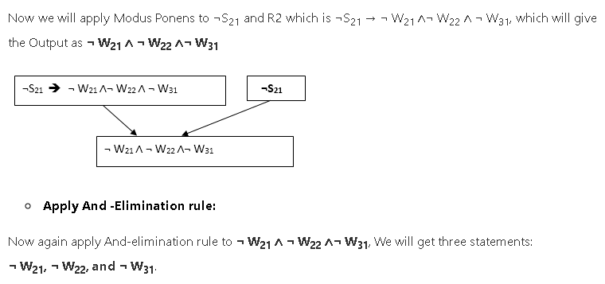

Slide 54
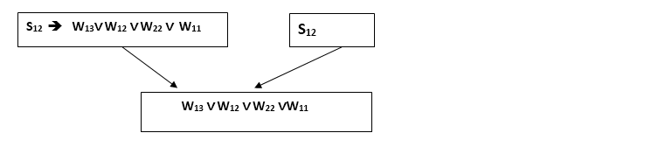
S₁₂ and R₄ which is S₁₂ → W₁₃ ∨. W₁₂ ∨. W₂₂ ∨.W₁₁, we will get the output as W₁₃∨ W₁₂ ∨ W₂₂ ∨.W₁₁.

Slide 55
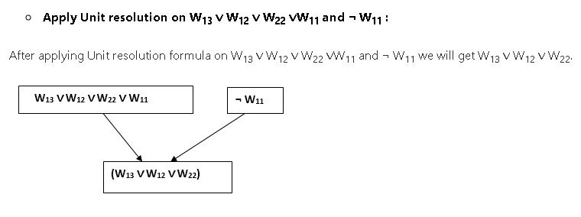

Slide 56
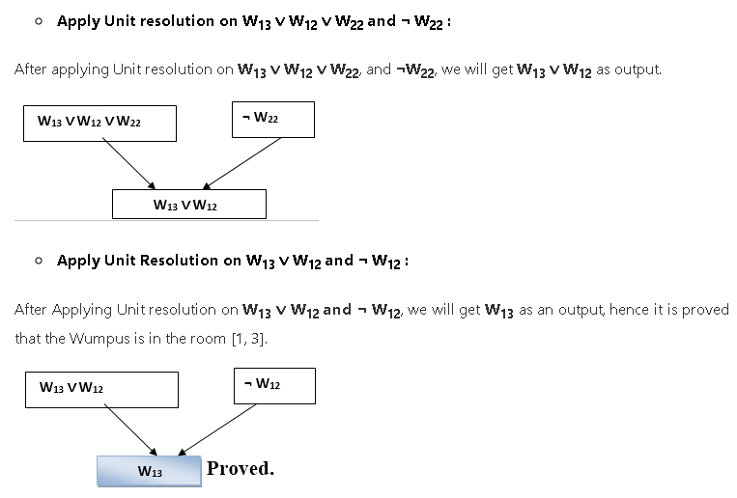

Slide 57
Forward Chaining and Backward Chaining in AI

Slide 58
Inference Engine
Inference is extracting conclusion or decision
The inference engine is the component of the intelligent system in artificial intelligence, which applies logical rules to the knowledge base to infer new information from known facts.
The first inference engine was part of the expert system.
Inference engine commonly proceeds in two modes, which are:
Forward Chaining
Backward Chaining

Slide 59
Forward Chaining
Also known as a forward deduction or forward reasoning method when it uses an inference engine.
The Forward-chaining algorithm
Starts from known facts,
Triggers all rules whose premises are satisfied,
Add their conclusion to the known facts.
Forward chaining is a form of reasoning which start with atomic sentences in the knowledge base and applies inference rules in the forward direction to extract more data until a goal is reached.
Initial state to goal state
Initial data is given and it finds out solution or conclusion
It is based on available data hence is Data driven approach
This process repeats until the problem is solved

Slide 60
Forward Chaining/Reasoning
It starts by finding all the rules whose left side matches with the initial / root node
For example,
While diagnosing a patient the doctor first check the symptoms and medical condition of the body such as temperature, blood pressure, pulse, eye colour, blood, etc..
After that, the patient symptoms are analysed and compared against the predetermined symptoms.
Then the doctor is able to provide the medicines according to the symptoms of the patient.
So, when a solution employs this manner of reasoning, it is known as forward chaining/reasoning.

Slide 61
Forward Chaining
Example:
It is raining- A
Road is wet - B
If it is raining road is wet A-> B
A is true is given fact, find if the road is wet or not
Example: x=1, y=2,
if (x==1 and y==2) then z=3)
if (x==2 and y==1) then z=5)
if z==5 then a=19
if z==4 then a=14
if z==3 then a=10
Find what is the value of a
Left side is given find right side

Slide 62
Backward Chaining:
Backward-chaining is also known as a backward deduction or backward reasoning method when using an inference engine.
A backward chaining algorithm is a form of reasoning, which starts with the goal and works backward, chaining through rules to find known facts that support the goal.
Goal Driven approach
Goal state to initial data requirement
Conclusion is given and find out required facts from which the conclusion can be reached

Slide 63
Definition of Backward Chaining
The backward reasoning is inverse of forward reasoning
It starts by finding all the rules whose right side matches with the goal node
Goal is analyzed in order to deduce the rules, initial facts and data.
We can understand the concept by the similar example,
In forward reasoning the doctor is trying to diagnose the patient with the help of the inceptive data such as symptoms.
However, in this case, the patient comes up with the name of disease, on the basis of which the doctor is going to prove and verify the symptoms.
This kind of reasoning comes under backward reasoning.

Slide 64
Backward Chaining
Example:
It is raining - A
Road is wet - B
If it is raining road is wet A-> B
Road is wet is fact
Example:
if (x==1 and y==2) then z=3
if z==3 then a=10
Value of a=10 is given find the values for x and y
Right side is given find left side

Slide 65
Properties of Forward-Chaining:
It is a bottom-up approach, as it moves from bottom to top.
It is a process of making a conclusion based on known facts or data, by starting from the initial state and reaches the goal state.
Forward-chaining approach is also called as data-driven as we reach to the goal using available data.
Forward-chaining approach is commonly used in the expert system, such as CLIPS, business, and production rule systems.

Slide 66
Steps that are followed in the forward chaining
The inference engine explores the knowledge base with the provided information for constraints whose precedence matches the given current state.
In the first step, the system is given with one or more than one constraints.
Then the rules are searched in the knowledge base for each constraint. The rules that fulfil the condition are selected (i.e., IF part).
Now each rule is able to produce new conditions from the conclusion of the invoked one. As a result, THEN part is again included in the existing one.
The added conditions are processed again by repeating step 2. The process will end if there is no new conditions exist.

Slide 67
Example of Forward Chaining
Encouraged students are always motivated. Along with motivation if student is healthy then only students can work hard. Hard-working students with goal are excellent students. Excellent students succeed. If Ram is encouraged, healthy and has goal find if Ram will succeed or not!
encouraged(student) -> motivated(Student)
motivated(student) AND healthy(student) -> work-hard(student)
work-hard(student) AND has(student, goal) -> Excellent(student)
Excellent(student) -> succeed(student)
encouraged(Ram), healthy(Ram), has(Ram, goal)

Slide 68
Properties of backward chaining:
It is known as a top-down approach.
Backward-chaining is based on modus ponens inference rule.
In backward chaining, the goal is broken into sub-goal or sub-goals to prove the facts true.
It is called a goal-driven approach, as a list of goals decides which rules are selected and used.
Backward chaining algorithm is used in game theory, automated theorem proving tools, inference engines, proof assistants, and various AI applications.
The backward-chaining method mostly uses a depth-first search strategy for proof.

Slide 69
Steps that are followed in the backward reasoning:
In this type of reasoning, the system chooses a goal state and reasons in the backward direction. Now, let’s understand how does it happens and what steps are followed.
Firstly, the goal state and the rules are selected where the goal state reside in the THEN part as the conclusion.
From the IF part of the selected rule the sub goals are made to be satisfied for the goal state to be true.
Set initial conditions important to satisfy all the sub goals.
Verify whether the provided initial state matches with the established states. If it fulfils the condition then the goal is the solution otherwise other goal state is selected.

Slide 70
Example of Backward Reasoning
encouraged(student) -> motivated(Student)
motivated(student) AND healthy(student) -> work-hard(student)
work-hard(student) AND has(student, goal) -> Excellent(student)
Excellent(student) -> succeed(student)
Ram succeeded, find facts about Ram.
to be excellent, subgoals are: student should be able to work hard and has goal
Student can work hard if he is healthy and motivated
Student is motivated if he is encouraged!

Slide 71
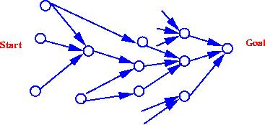
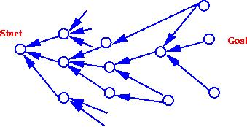

Slide 72
BASIS FOR COMPARISON | FORWARD CHAINING | BACKWARD CHAINING
Basic | Data-driven | Goal driven
Begins with | New Data | Uncertain conclusion
Objective is to find the | Conclusion that must follow | Facts to support the conclusions
Type of approach | Opportunistic | Conservative
Flow | Incipient to consequence | Consequence to incipient

Slide 73
Example:
"As per the law, it is a crime for an American to sell weapons to hostile nations. Country A, an enemy of America, has some missiles, and all the missiles were sold to it by Robert, who is an American citizen."
Prove that "Robert is criminal."
To solve the above problem, first, we will convert all the above facts into first-order definite clauses, and then we will use a forward-chaining algorithm to reach the goal.

Slide 74
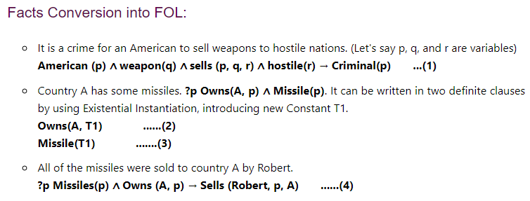

Slide 75
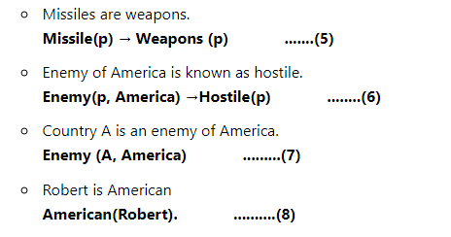

Slide 76
Forward chaining proof:
Step-1:
In the first step we will start with the known facts and will choose the sentences which do not have implications, such as: American(Robert), Enemy(A, America), Owns(A, T1), and Missile(T1). All these facts will be represented as below.

Slide 77
Step-2:
At the second step, we will see those facts which infer from available facts and with satisfied premises.
Rule-(1) does not satisfy premises, so it will not be added in the first iteration.
Rule-(2) and (3) are already added.
Rule-(4) satisfy with the substitution {p/T1}, so Sells (Robert, T1, A) is added, which infers from the conjunction of Rule (2) and (3).
Rule-(6) is satisfied with the substitution(p/A), so Hostile(A) is added and which infers from Rule-(7).

Slide 78
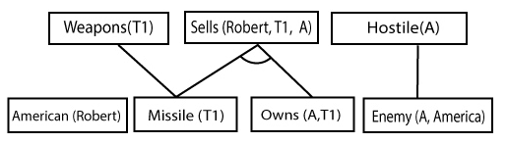

Slide 79
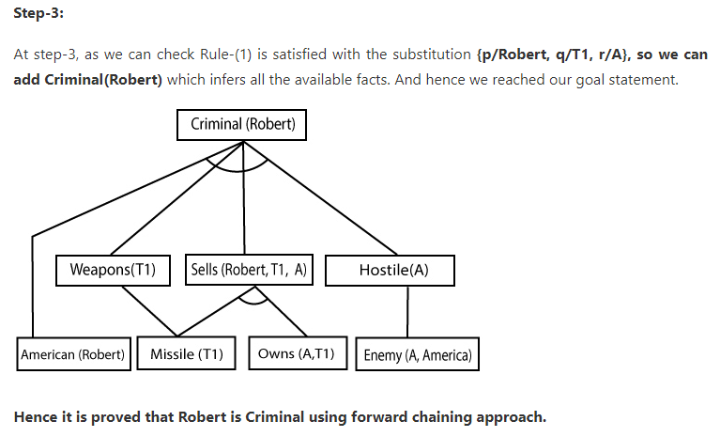

Slide 80
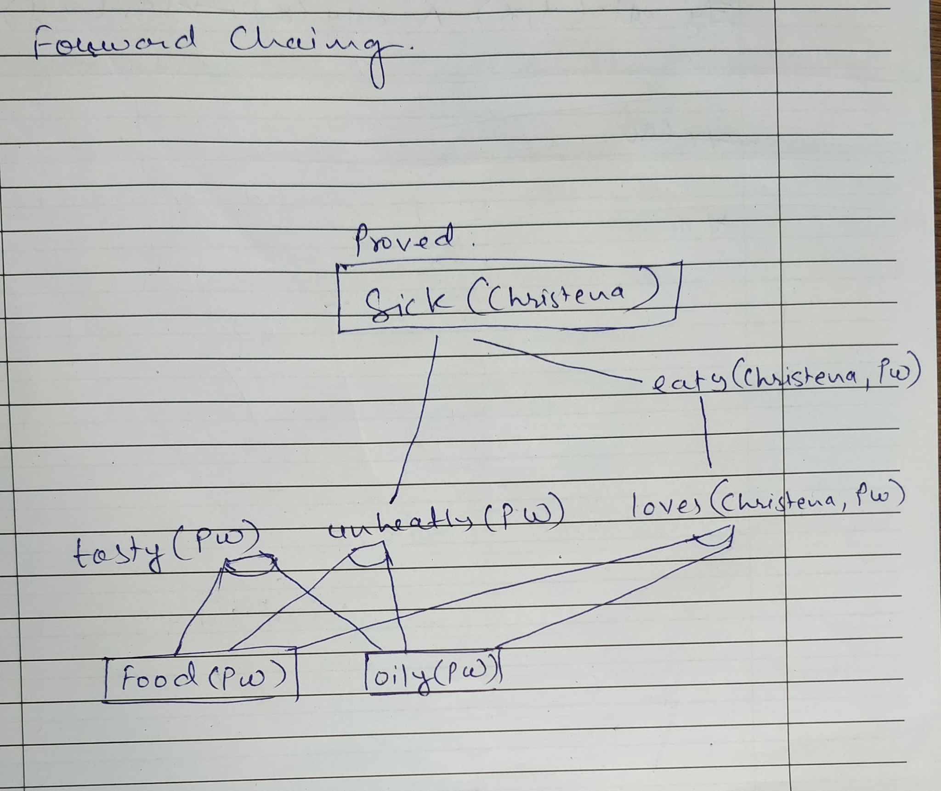
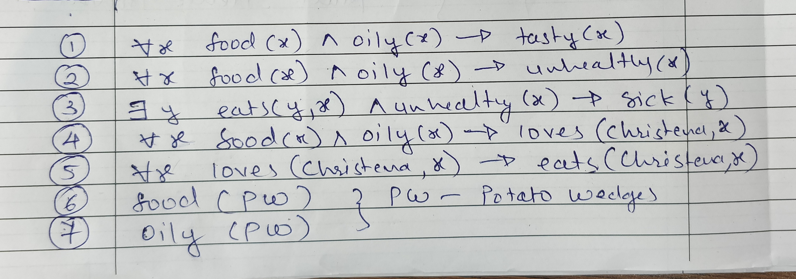
Explain Forward chaining in detail. Examine how it is different from Backward chaining?
Using the forward chaining method to find if Christena is healthy or sick. Following is the given information:
If food is oily it is good in taste and not good for health. If anyone eats unhealthy food they fall sick. Christena loves oily food and she eats only what she loves. “Potato wedges” is an oily food item.

Slide 81
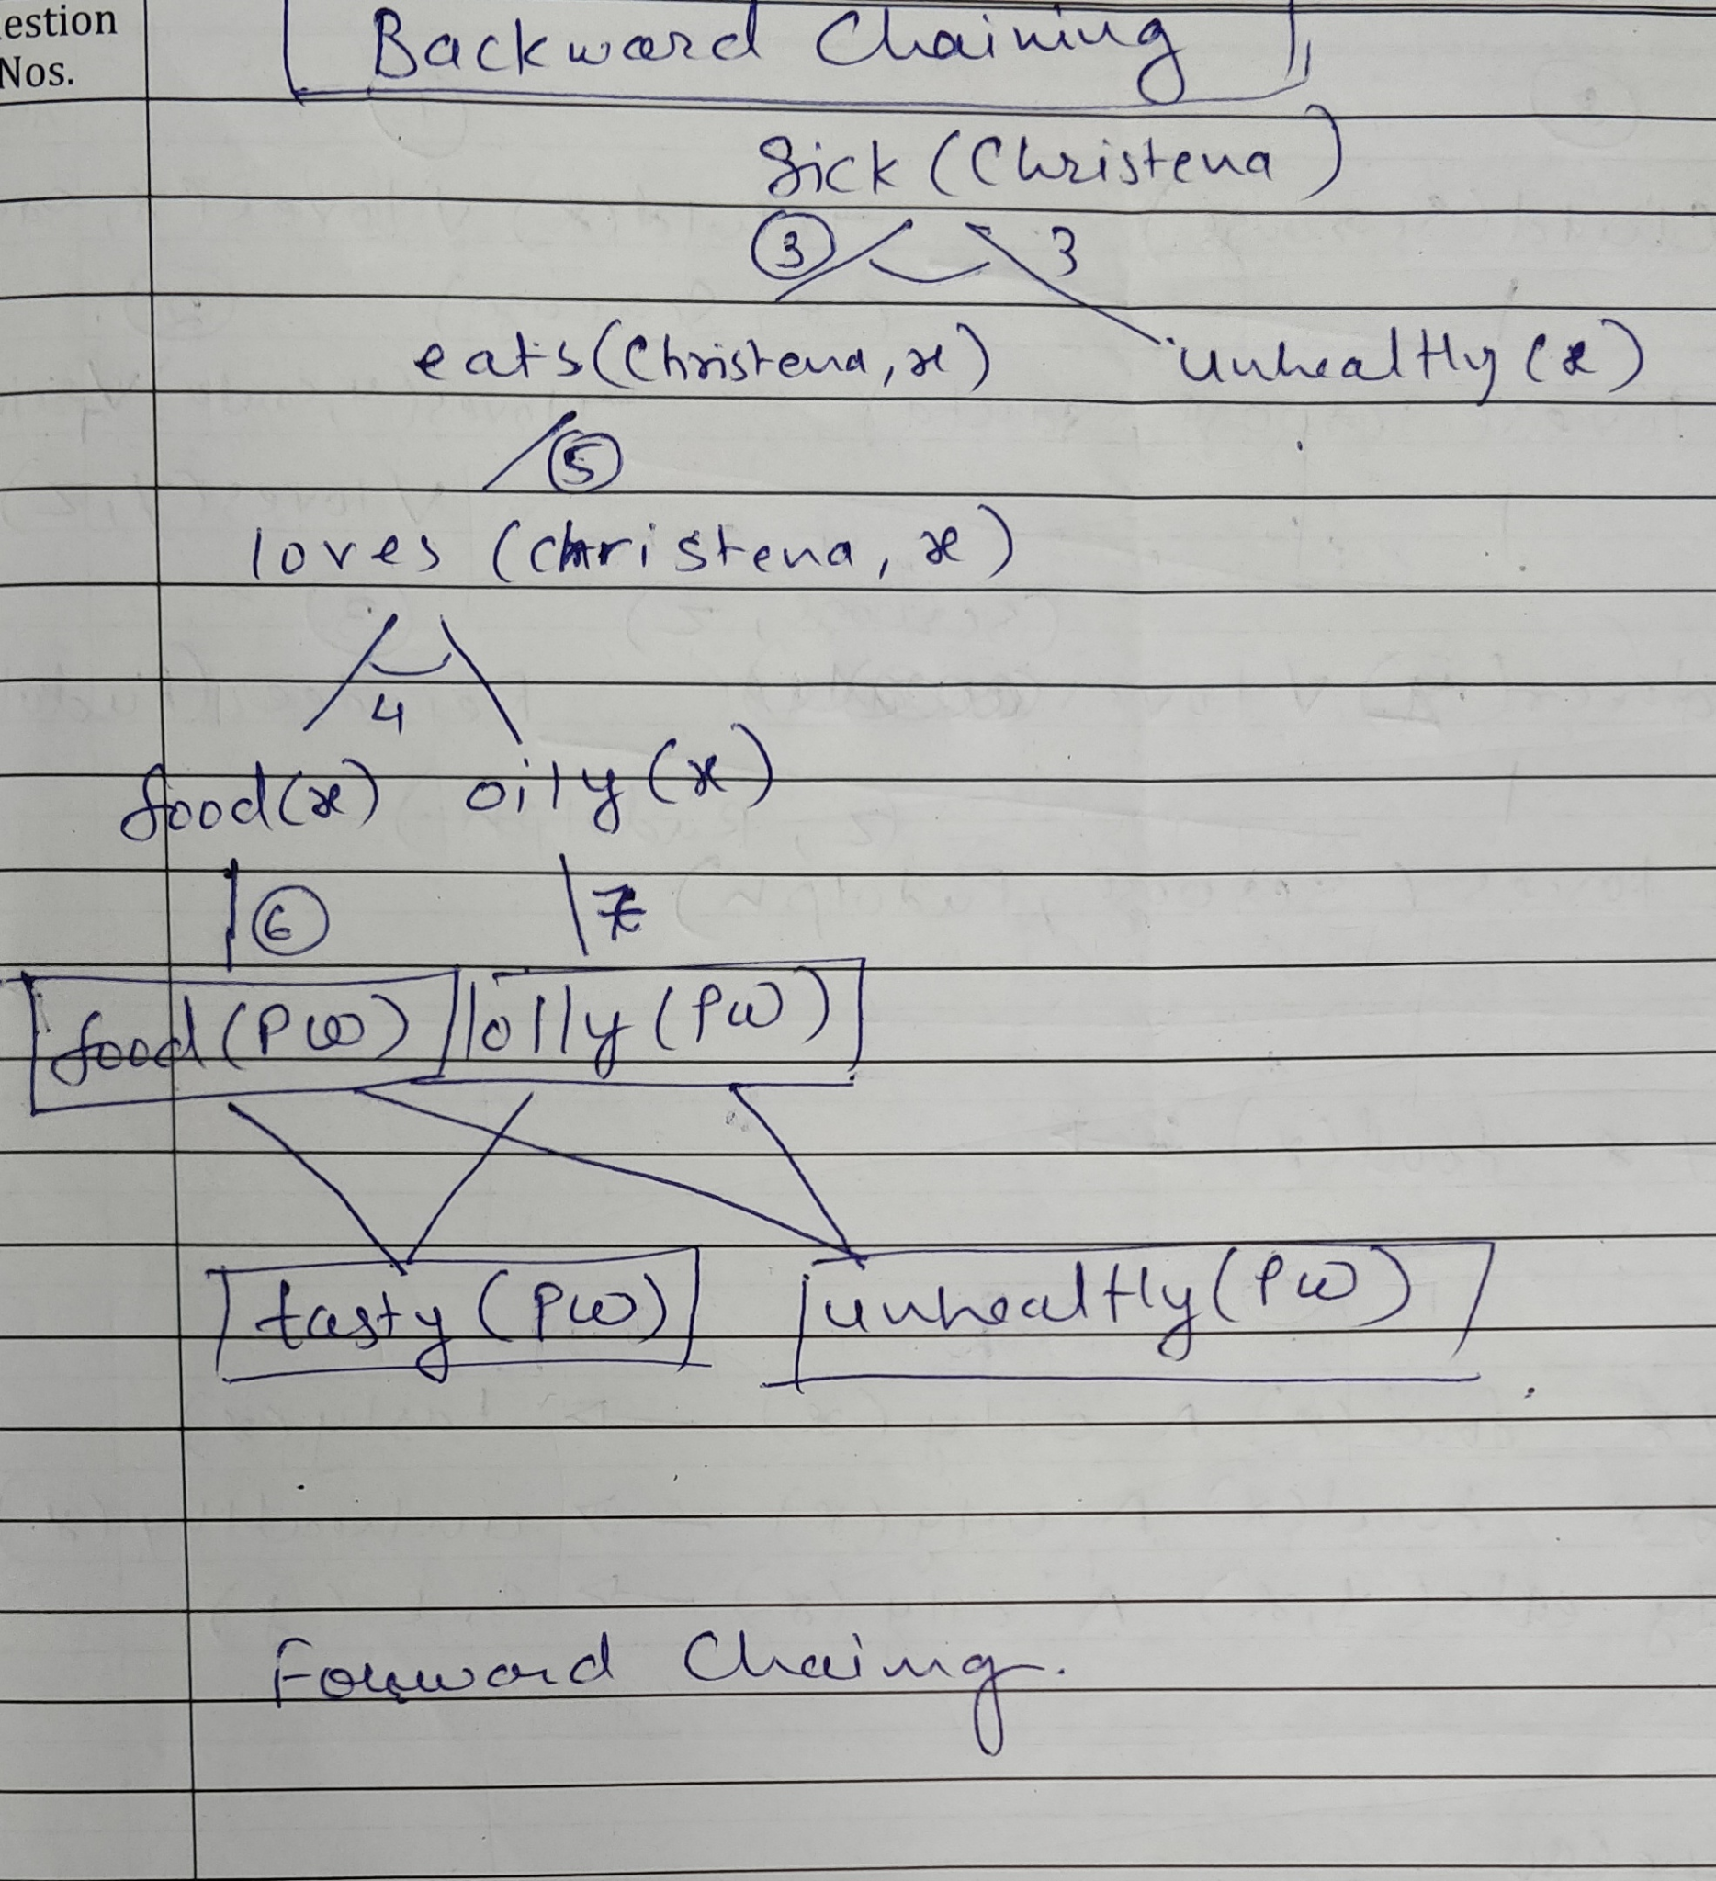
Explain Backward chaining in detail. Examine how it is different from forward chaining? Using the Backward chaining method, find the facts supporting Christena is sick. Following is the given information:
If food is oily it is good in taste and not good for health. If anyone eats unhealthy food they fall sick. Christena loves oily food and she eats only what she loves. “Potato wedges” is an oily food item.

Slide 82
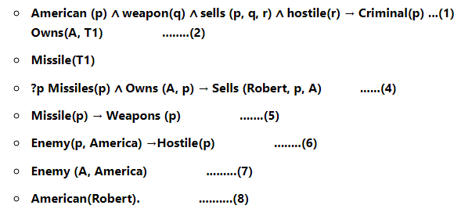
Example:
In backward-chaining, we will use the same above example, and will rewrite all the rules.

Slide 83

Backward-Chaining proof:
In Backward chaining, we will start with our goal predicate, which is Criminal(Robert), and then infer further rules.
Step-1:
At the first step, we will take the goal fact. And from the goal fact, we will infer other facts, and at last, we will prove those facts true. So our goal fact is "Robert is Criminal," so following is the predicate of it.

Slide 84
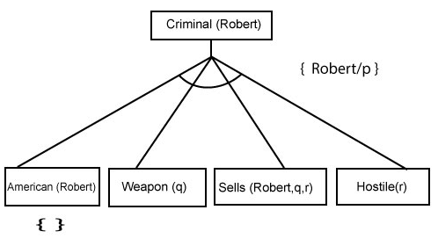
Step-2: At the second step, we will infer other facts form goal fact which satisfies the rules. So as we can see in Rule-1, the goal predicate Criminal (Robert) is present with substitution {Robert/P}. So we will add all the conjunctive facts below the first level and will replace p with Robert.
Here we can see American (Robert) is a fact, so it is proved here.

Slide 85
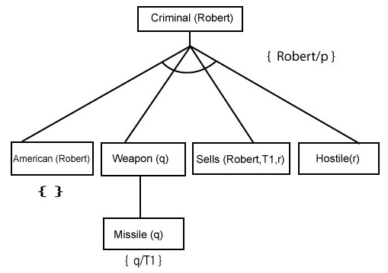
Step-3:t At step-3, we will extract further fact Missile(q) which infer from Weapon(q), as it satisfies Rule-(5). Weapon (q) is also true with the substitution of a constant T1 at q.

Slide 86
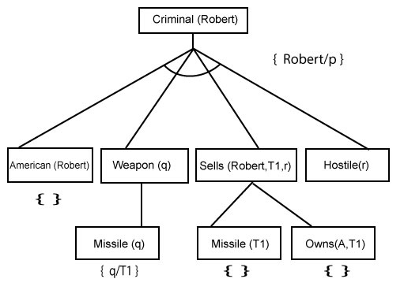
Step-4: At step-4, we can infer facts Missile(T1) and Owns(A, T1) form Sells(Robert, T1, r) which satisfies the Rule- 4, with the substitution of A in place of r. So these two statements are proved here.

Slide 87
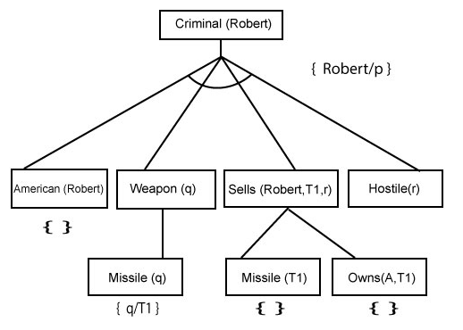

Slide 88
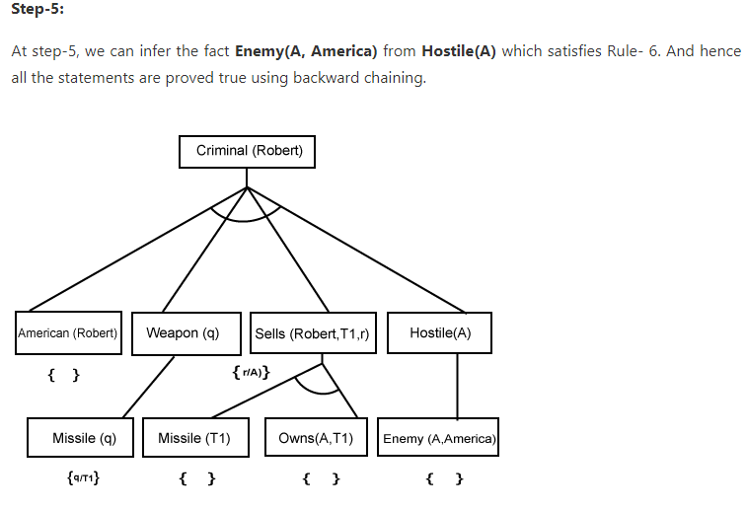

Slide 89
S. No. | Forward Chaining | Backward Chaining
1 | Forward chaining starts from known facts and applies inference rule to extract more data unit it reaches to the goal. | Backward chaining starts from the goal and works backward through inference rules to find the required facts that support the goal.
2 | It is a bottom-up approach | It is a top-down approach
3 | Forward chaining is known as data-driven inference technique as we reach to the goal using the available data. | Backward chaining is known as goal-driven technique as we start from the goal and divide into sub-goal to extract the facts.
4 | Forward chaining reasoning applies a breadth-first search strategy. | Backward chaining reasoning applies a depth-first search strategy.
5 | Forward chaining tests for all the available rules | Backward chaining only tests for few required rules.
6 | Forward chaining is suitable for the planning, monitoring, control, and interpretation application. | Backward chaining is suitable for diagnostic, prescription, and debugging application.
7 | Forward chaining can generate an infinite number of possible conclusions. | Backward chaining generates a finite number of possible conclusions.
8 | It operates in the forward direction. | It operates in the backward direction.
9 | Forward chaining is aimed for any conclusion. | Backward chaining is only aimed for the required data.

Slide 90
Resolution
Resolution is a theorem proving technique that proceeds by building refutation proofs, i.e., proofs by contradictions.
Resolution is used, if there are various statements are given, and we need to prove a conclusion of those statements.
Resolution is a single inference rule which can efficiently operate on the conjunctive normal form or clausal form.
Clause: Disjunction of literals (an atomic sentence) is called a clause. It is also known as a unit clause.
Conjunctive Normal Form: A sentence represented as a conjunction of clauses is said to be conjunctive normal form or CNF.
The resolution rule for first-order logic is simply a lifted version of the propositional rule. Resolution can resolve two clauses if they contain complementary literals, which are assumed to be standardized apart so that they share no variables.

Slide 91
Steps for Resolution
Steps for Resolution:
Conversion of facts into first-order logic.
Convert FOL statements into CNF
Negate the statement which needs to prove (proof by contradiction)
Draw resolution graph.

Slide 92
Example
All people who are graduating are happy
All happy people smile
Someone is graduating
Prove someone is smiling = true using resolution
Draw resolution tree

Slide 93
All people who are graduating are happy
All happy people smile
Someone is graduating
someone is smiling
Step 1. Conversion of facts into first-order logic.
∀x: graduating(x) → happy(x)
∀x: happy(x) → smile(x)
∃x: graduating(x)
∃x: smile(x)
We take negation of the final statement and prove with contradiction
Hence, ¬ (∃x: smile(x))

Slide 94
Rules for Converting FOL to CNF
Elimination of implications (→ )
a→ b is equal to ¬ aVb
Move ¬ inwards
¬ (a V b) = ¬a Λ ¬b
¬ (a Λ b) = ¬a V ¬b
¬ ¬ a = a
Standardize variables
Drop universal quantifiers

Slide 95
Remove implications:
∀x: ¬ graduating(x) V happy(x)
∀x: ¬ happy(x) V smile(x)
∃x: graduating(x)
¬ (∃x: smile(x))
∀x: graduating(x) → happy(x)
∀x: happy(x) → smile(x)
∃x: graduating(x)
¬ (∃x: smile(x))

Slide 96
∀x: graduating(x) → happy(x)
∀x: happy(x) → smile(x)
∃x: graduating(x)
¬ (∃x: smile(x))
Remove implications:
∀x: ¬ graduating(x) V happy(x)
∀x: ¬ happy(x) V smile(x)
∃x: graduating(x)
¬ (∃x: smile(x))
Standardize variables:
∀x: ¬ graduating(x) V happy(x)
∀y: ¬ happy(y) V smile(y)
∃z: graduating(z)
¬ (∃w: smile(w))

Slide 97
∀x: graduating(x) → happy(x)
∀x: happy(x) → smile(x)
∃x: graduating(x)
¬ (∃x: smile(x))
Remove implications:
∀x: ¬ graduating(x) V happy(x)
∀x: ¬ happy(x) V smile(x)
∃x: graduating(x)
¬ (∃x: smile(x))
Standardize variables:
∀x: ¬ graduating(x) V happy(x)
∀y: ¬ happy(y) V smile(y)
∃z: graduating(z)
¬ (∃w: smile(w))
Move negation inverds and remove quantifiers :
¬ graduating(x) V happy(x)
¬ happy(y) V smile(y)
graduating(z)
¬ smile(w)

Slide 98
Negate the statement which needs to prove (proof by contradiction)
In this statement, we will apply negation to the conclusion statements, which will be written as
¬ smile(w)
Start with negation
Find contradicting rules
Contradiction is proved when it returns NULL

Slide 99
Example
John likes all kind of food.
Apple and vegetable are food
Anything anyone eats and not killed is food.
Anil eats peanuts and still alive
Harry eats everything that Anil eats.
John likes peanuts.

Slide 100
Example
Step 1. Conversion of facts into first-order logic.
∀x: food(x) → likes(John, x)
food(Apple) Λ food(vegetables)
∀x ∀y : eats(x, y) Λ ¬ killed(x) → food(y)
eats (Anil, Peanuts) Λ alive(Anil)
∀x eats(Anil, x) → eats(Harry, x)
likes(John,peanuts)
John likes all kind of food.
Apple and vegetable are food
Anything anyone eats and not killed is food.
Anil eats peanuts and still alive
Harry eats everything that Anil eats.
John likes peanuts.

Slide 101
FOL to CNF Conversion
Step 1. Conversion of facts into first-order logic.
∀x: food(x) → likes(John, x)
food(Apple) Λ food(vegetables)
∀x ∀y : eats(x, y) Λ ¬ killed(x) → food(y)
eats (Anil, Peanuts) Λ alive(Anil)
∀x: eats(Anil, x) → eats(Harry, x)
∀x : ¬ killed(x) → alive(x)
∀x: alive(x) → ¬ killed(x)
likes(John,peanuts)
Step 2. Eliminate all implication (→) and rewrite
∀x ¬ food(x) V likes(John, x)
food(Apple) Λ food(vegetables)
∀x ∀y ¬ [eats(x, y) Λ ¬ killed(x)] V food(y)
eats (Anil, Peanuts) Λ alive(Anil)
∀x ¬ eats(Anil, x) V eats(Harry, x)
∀x¬ [¬ killed(x) ] V alive(x)
∀x ¬ alive(x) V ¬ killed(x)
likes(John, Peanuts).

Slide 102
Move negation inwards
Step 3. Move negation (¬)inwards and rewrite
∀x ¬ food(x) V likes(John, x)
food(Apple) Λ food(vegetables)
∀x ∀y ¬ eats(x, y) V killed(x) V food(y)
eats (Anil, Peanuts) Λ alive(Anil)
∀x ¬ eats(Anil, x) V eats(Harry, x)
∀x killed(x) V alive(x)
∀x ¬ alive(x) V ¬ killed(x)
likes(John, Peanuts).
Step 2. Eliminate all implication (→) and rewrite
∀x ¬ food(x) V likes(John, x)
food(Apple) Λ food(vegetables)
∀x ∀y ¬ [eats(x, y) Λ ¬ killed(x)] V food(y)
eats (Anil, Peanuts) Λ alive(Anil)
∀x ¬ eats(Anil, x) V eats(Harry, x)
∀x¬ [¬ killed(x) ] V alive(x)
∀x ¬ alive(x) V ¬ killed(x)
likes(John, Peanuts).

Slide 103
Rename/ standardize Variables
Step 3. Move negation (¬)inwards and rewrite
∀x ¬ food(x) V likes(John, x)
food(Apple) Λ food(vegetables)
∀x ∀y ¬ eats(x, y) V killed(x) V food(y)
eats (Anil, Peanuts) Λ alive(Anil)
∀x ¬ eats(Anil, x) V eats(Harry, x)
∀x killed(x) V alive(x)
∀x ¬ alive(x) V ¬ killed(x)
likes(John, Peanuts).
Step 4. Rename variables or standardize variables
∀x ¬ food(x) V likes(John, x)
food(Apple) Λ food(vegetables)
∀y ∀z ¬ eats(y, z) V killed(y) V food(z)
eats (Anil, Peanuts) Λ alive(Anil)
∀w¬ eats(Anil, w) V eats(Harry, w)
∀g killed(g) V alive(g)
∀k ¬ alive(k) V ¬ killed(k)
likes(John, Peanuts).

Slide 104
Drop Universal Quantifiers
Step 4. Rename variables or standardize variables
∀x ¬ food(x) V likes(John, x)
food(Apple) Λ food(vegetables)
∀y ∀z ¬ eats(y, z) V killed(y) V food(z)
eats (Anil, Peanuts) Λ alive(Anil)
∀w¬ eats(Anil, w) V eats(Harry, w)
∀g killed(g) V alive(g)
∀k ¬ alive(k) V ¬ killed(k)
likes(John, Peanuts).
Step 5. Drop Universal quantifiers
¬ food(x) V likes(John, x)
food(Apple)
food(vegetables)
¬ eats(y, z) V killed(y) V food(z)
eats (Anil, Peanuts)
alive(Anil)
¬ eats(Anil, w) V eats(Harry, w)
killed(g) V alive(g)
¬ alive(k) V ¬ killed(k)
likes(John, Peanuts).

Slide 105
Negate the statement which needs to prove (proof by contradiction)
In this statement, we will apply negation to the conclusion statements, which will be written as
¬likes(John, Peanuts)
Start with negation
Find contradicting rules
Contradiction is proved when it returns NULL

Slide 106
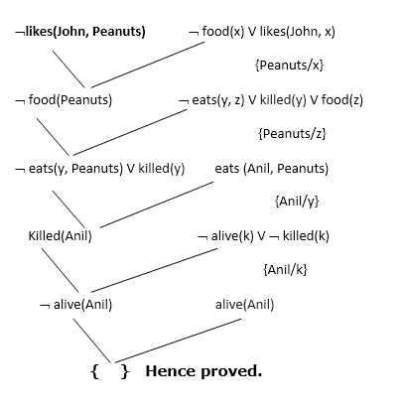
¬ food(x) V likes(John, x)
food(Apple)
food(vegetables)
¬ eats(y, z) V killed(y) V food(z)
eats (Anil, Peanuts)
alive(Anil)
¬ eats(Anil, w) V eats(Harry, w)
killed(g) V alive(g)
¬ alive(k) V ¬ killed(k)
likes(John, Peanuts).

Slide 107
Explanation of Resolution Graph
In the first step of resolution graph, ¬likes(John, Peanuts) , and likes(John, x) get resolved(canceled) by substitution of {Peanuts/x}, and we are left with ¬ food(Peanuts)
In the second step of the resolution graph, ¬ food(Peanuts) , and food(z) get resolved (canceled) by substitution of { Peanuts/z}, and we are left with ¬ eats(y, Peanuts) V killed(y) .
In the third step of the resolution graph, ¬ eats(y, Peanuts) and eats (Anil, Peanuts) get resolved by substitution {Anil/y}, and we are left with Killed(Anil) .
In the fourth step of the resolution graph, Killed(Anil) and ¬ killed(k) get resolve by substitution {Anil/k}, and we are left with ¬ alive(Anil) .
In the last step of the resolution graph ¬ alive(Anil) and alive(Anil) get resolved.

Slide 108
THE END

